Slide 1
SAVE YOURSELF
By Shravan Parmar
TY.IT - 456

Slide 2
ABOUT THE WEBSITE
The motive is to reach those people in need for help. Save yOURself is an NGO. A non-profitable website which helps people across the country. The objective of this foundation is to provide proper livelihood for homeless and those below poverty line.
It helps through the donation made by the people by this website. This mainly includes donating books for poor children , old and warm clothes especially for winter. The organization also helps by providing sanitation and dignity kits for women. All this donation is done through the people, we just hand it over to person in need. In short Save yOURself is a platform where you can donate your belongings and we’ll make sure your donation is of worth.

Slide 3
OBJECTIVES
The main objective of a NGO foundation is to give service and help to provide good a environment for everyone.
Here in Save yOURself the donor need not donate money in fund raising as in every other NGO website.
Instead we encourage people to give away those thing which the people are really in need of.
By taking this step the donor can be somewhat assured that their money is not misused and atleast their donation is really helping to make a change in the society.

Slide 4
PURPOSE
This foundation is managed by the resources, funds and other kind of desirable support of Government, funding agencies, support agencies, support communities, with support and help of business group and people.
Save yOURself can get help to run in a variety of sources, including the fees of member, private donations, grants, sales of goods and services. Save yOURself is a non profit making organization, works for no profit and no gain so it is also can be called as a Non Profit Organization.

Slide 5
SCOPE
The whole website is based on the planning of donating goods through us. The donor can use the website to donate their things as they wish to and we’ll take their donated stuff and pass them out to the needy by our own hands.
As many people want to donate their belongings to people in need but sometimes they have no idea how, when and where to donate them. To solve this problem we help them to donate and help.

Slide 6
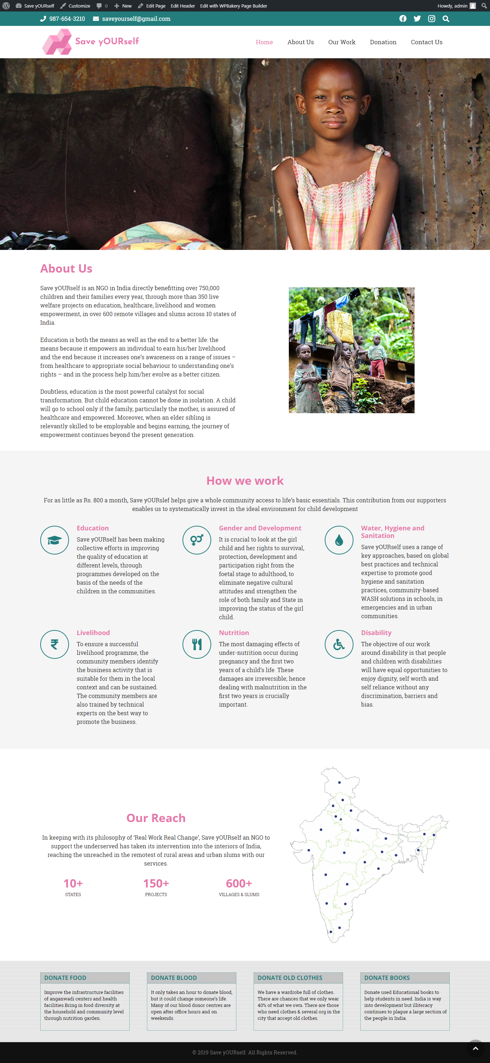
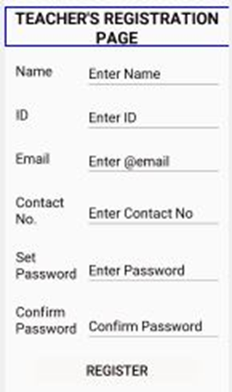
USER INTERFACE

Slide 7
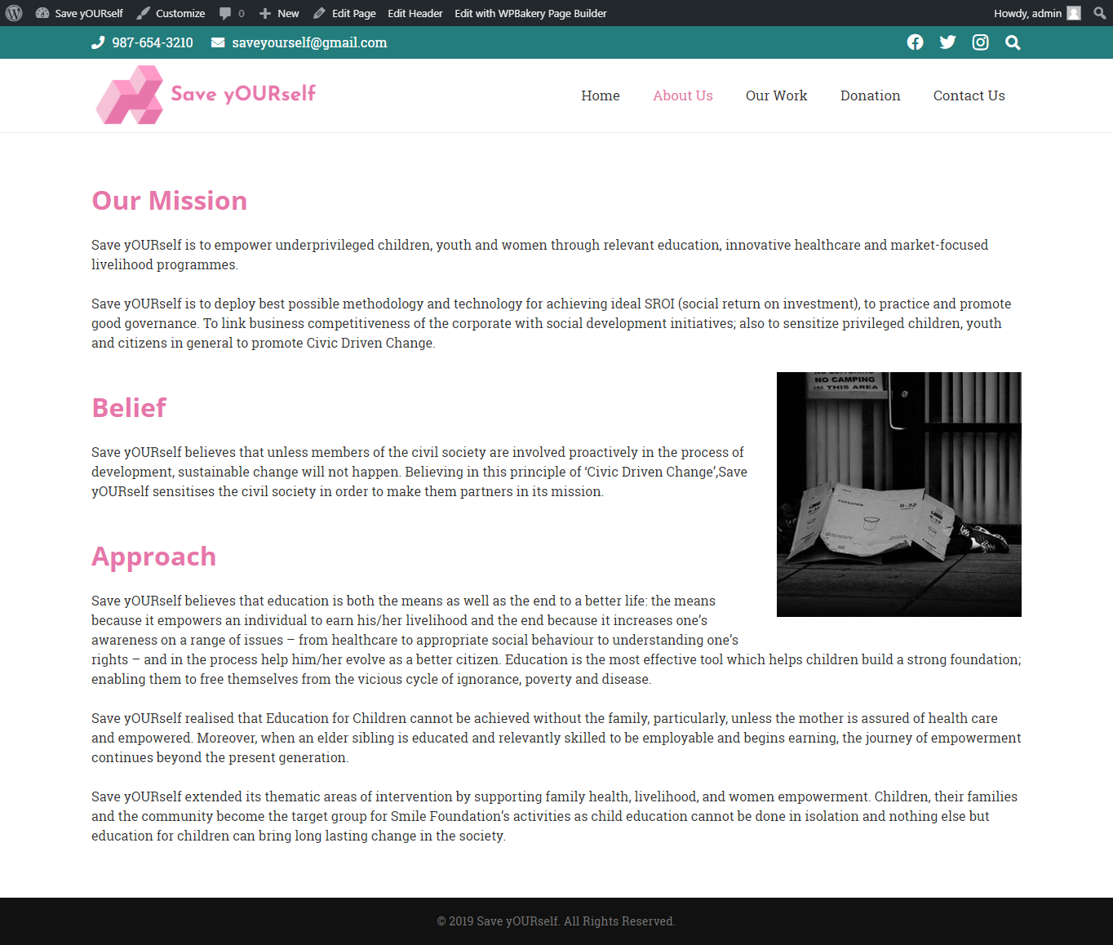
USER INTERFACE

Slide 8
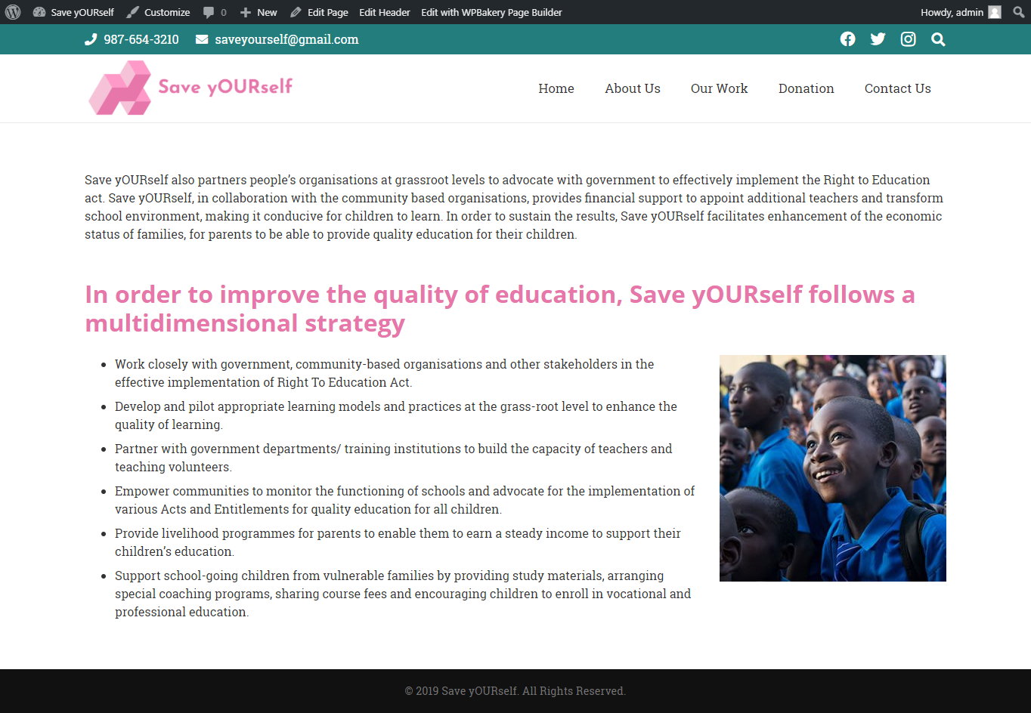
USER INTERFACE

Slide 9
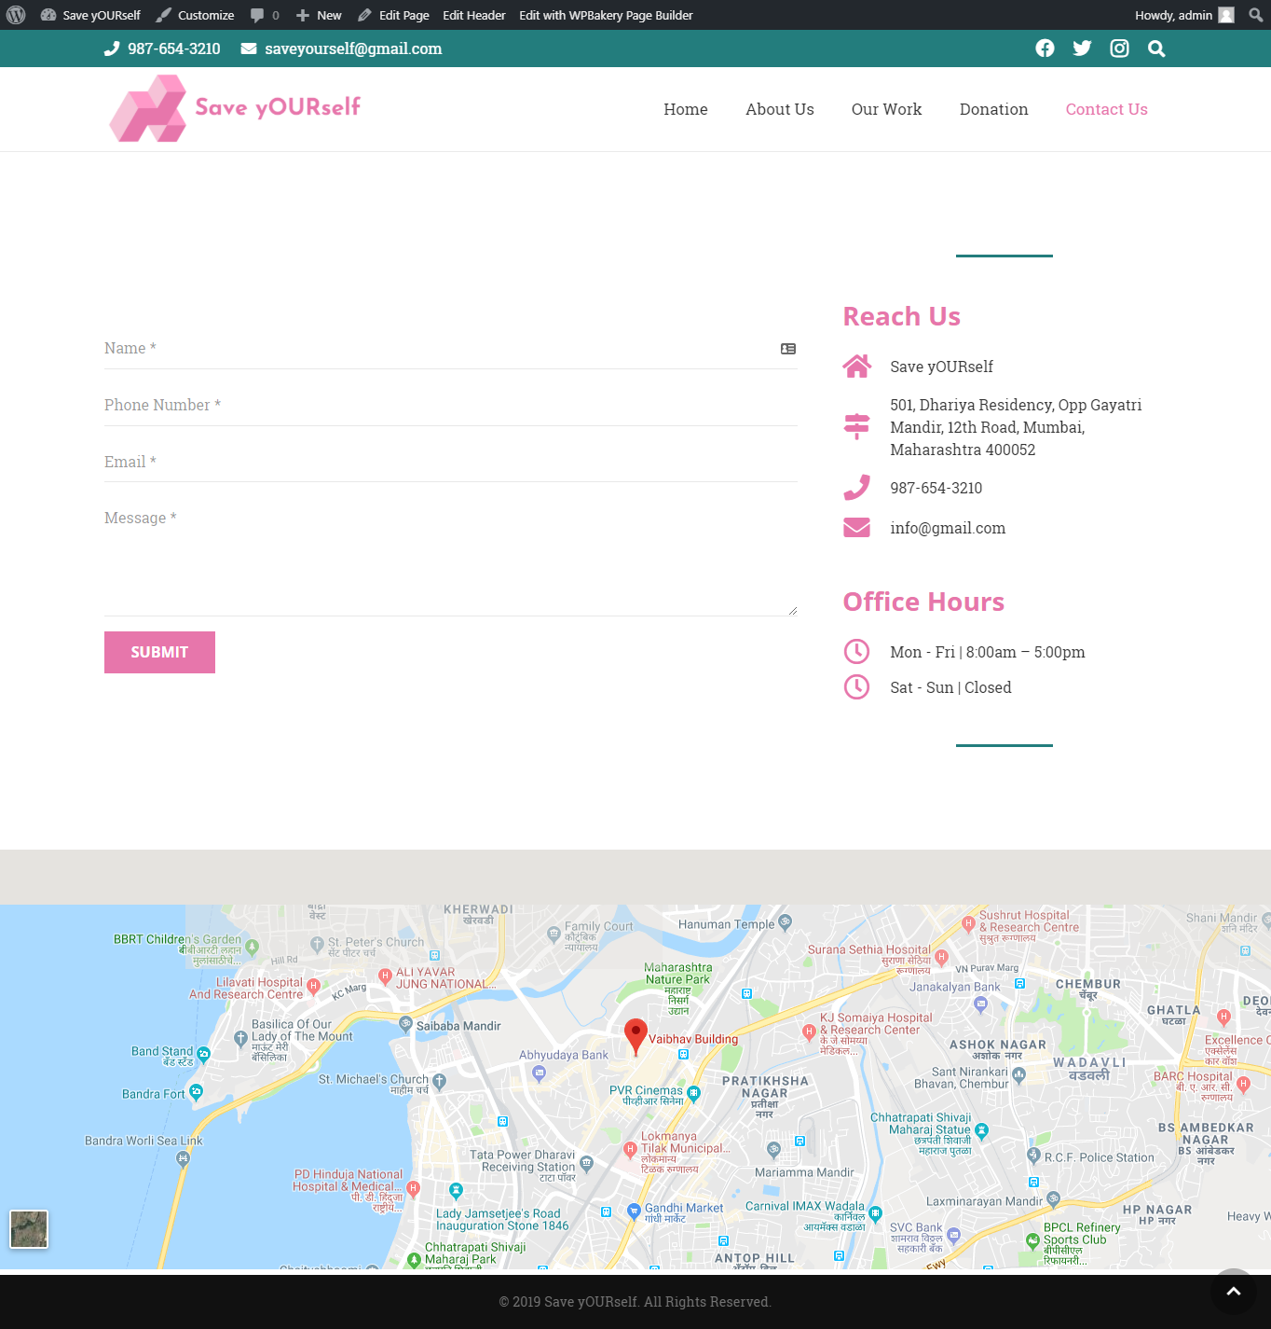
USER INTERFACE

Slide 10
TECHNICAL REQUIREMENTS
Hardware: -Intel Core i3 Series 5th Generation Processor
RAM – 4GB
ROM -1024GB
Software: -Xampp version 3.2.4
PhpMyAdmin version 4.9.0.1
MySQL
Adobe Photoshop CC 2015

Slide 11
ADVANTAGES
Our proposed system is Save yOURself on Wordpress which is a NGO website. This is a Non Profitable Organization. This system is used to promote the donation of things directly to people in need through website. Here the donor can donate directly and the risk of scam decreases on large scale.
As their donated things are distributed by the volunteers’. These volunteers distribute the donated items by their own hands. Making the risk of misuse of the donated items less compared to those websites which prefer donation of money instead of kits which may be useful for the poor people.
The main motive of Save yOURself is to make the surrounding area, community and environment better for everyone. This foundation has covered most of the states in our country with multiple centers for distribution and storage as a donation camp.

Slide 12
DISADVANTAGE
Internet is the core of this project and without internet there won’t be any access to the features of the project.
This website is only available for our country, It does not cover other remote places across the country. The website cannot be accessed when the user is offline.

Slide 13
CONCLUSION
Users can only use my website Online. Website will help the user to gain information about different types of donation across the states.
With the help of this website planning of the user becomes easier and it also helps the user to compare from different website which lessens the risk of scam of money donated through online donation system.

